Slide 1
Building Classes in Java
Translating Basic OOP concepts

Slide 2
Classes in Java:
Same Idea as Python, More Structure
  Both Python and Java are object-oriented languages, however:
    Python can take an OO approach
    Java demands an OO approach
  Python leaves a lot of class design implicit:
    Duck typing on data (parameters, returns, attributes etc)
    Accessibility rules are more suggestion than barriers
  Java is far more explicit in its class design:
    Types must be specified (parameters, returns, attributes/fields etc)
    Accessibility is defined with keywords – public, private, protected

Slide 3
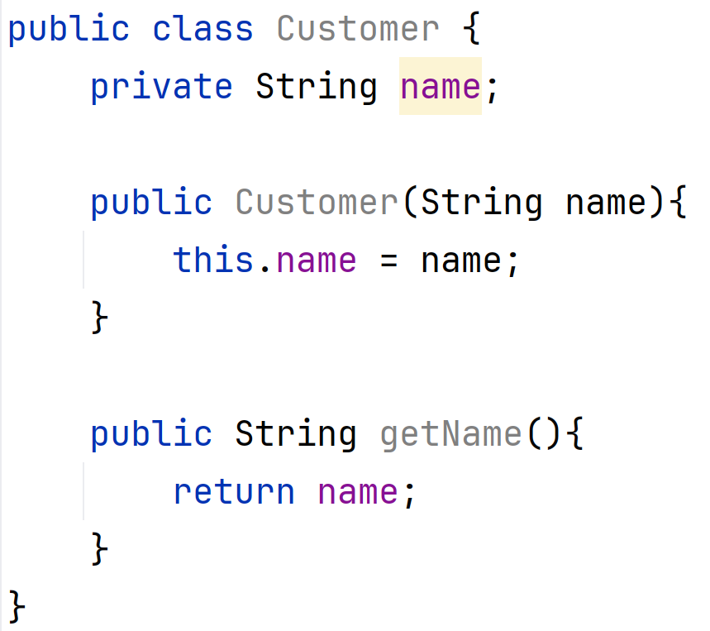
Declaring a Class: Attributes
  Java class structure is slightly different to python
    Instance attributes (variables) are listed at the top of the class
      UNDER the class signature
      OUTSIDE all methods
  Attributes have an access modifier keyword
    public: accessible everywhere
    private: accessible only in this class (default to this!)
    protected: accessible in this class & subclasses
  Attributes can be accessed using the this keyword
    However, it’s not REQUIRED

Slide 4
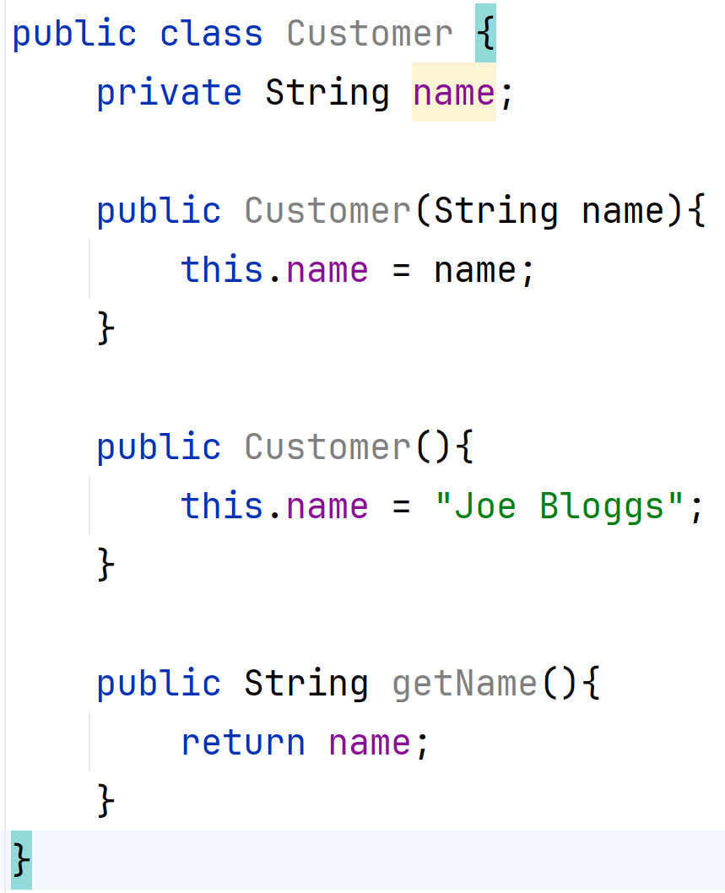
Declaring a Class: Constructors
  Java constructors do not have a dedicated name
    The constructor always has the same name as the class (Customer here)
  Java allows for multiple constructors in the same class
    Different constructors for different use cases – fine as long as there are different parameter lists
    This offsets not including required vs optional parameters

Slide 5
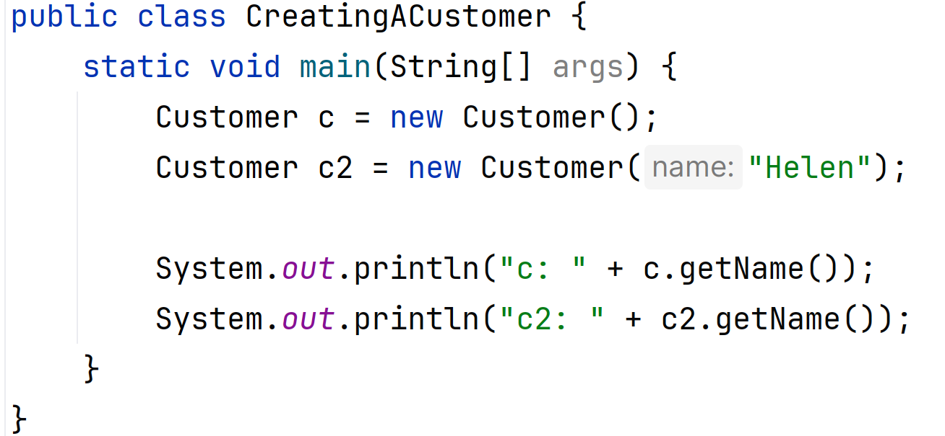
Creating an Object in Java
  The new keyword (combined with the constructor) creates an object in Java
  The constructor called depends on the parameters provided
    Method overloading in action!
  We have no way to see the data inside the class (private variable)
    Need to use getter method to show it

Slide 6
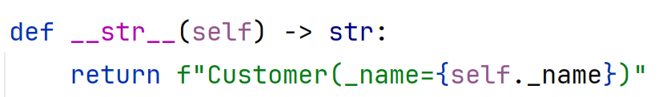
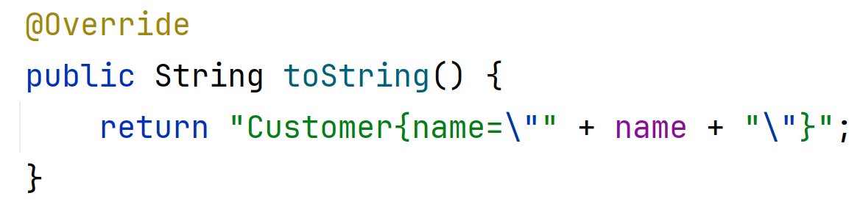
“Good Practice” Methods in Java:
Converting an Object to Text
  In python, we use __str__() to convert an object to text
    Takes almost no parameters (needs self)
    Creates and returns a string containing the data
  In Java, we use toString()
    Takes no parameters
    Creates & returns a String containing the data
    Can be marked with @Override, but not required

Slide 7
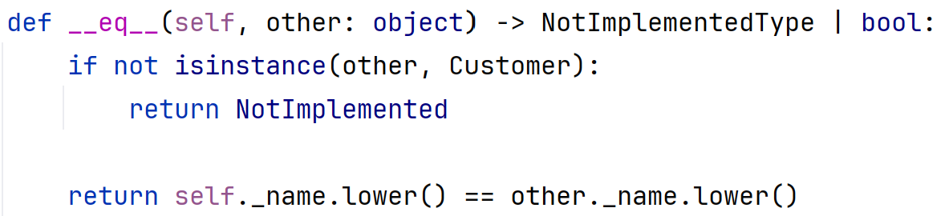
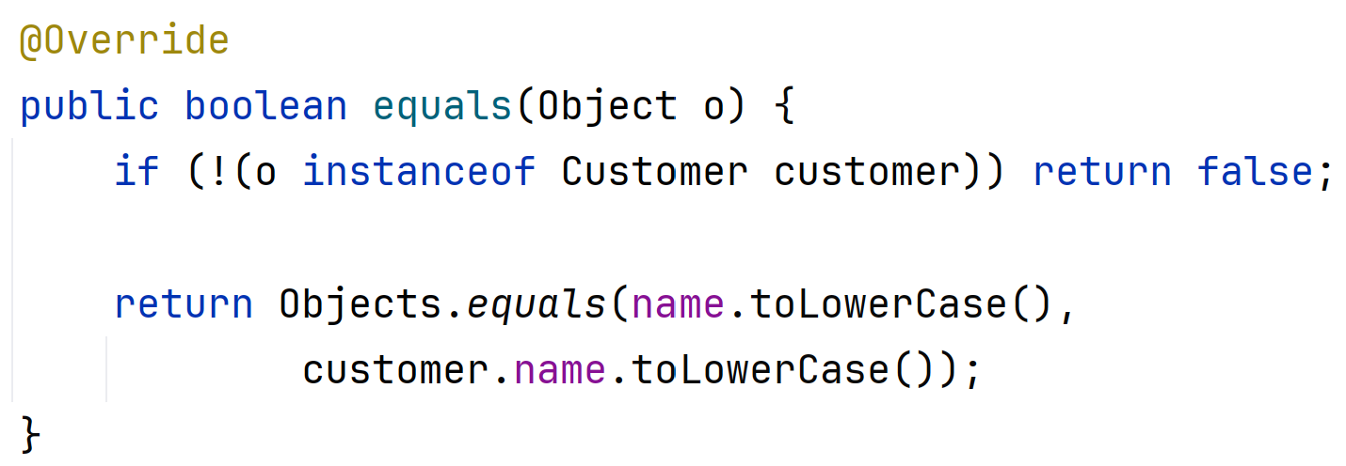
“Good Practice” Methods in Java:
Checking For Equality
  In python, we use __eq__() and __ne__() to compare one object to another
    Takes two parameters (needs self and the object to compare against)
    Returns NotImplemented for incorrect types
    Returns True or False based on check logic
  In Java, we use equals()
    Only takes in object to compare against
    Same steps: check type, then check data
    Returns true or false, even for incorrect type!
    Can be marked with @Override, but not required

Slide 8
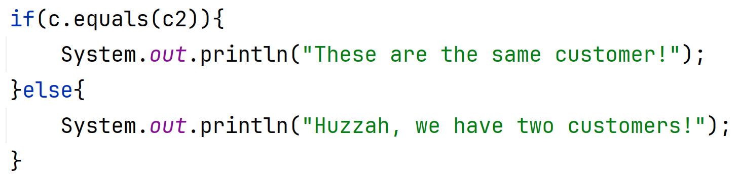
Using the equals() method:
Checking Objects for Equality
  We cannot use == to compare two objects in Java
    Operators are for simple types, e.g. ints, doubles, booleans etc
  Must use our equals() method directly
    No magic method set up in Java!

Slide 9
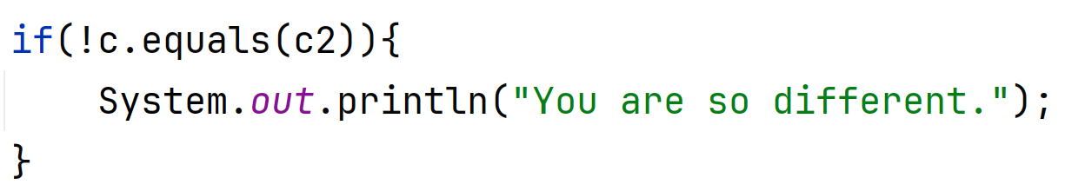
Using the equals() method:
Checking Objects for Inequality
  We cannot use != to check two objects are not the same
  Must call equals() method and negate/invert the result
    We achieve this with the ! (not) operator

Slide 10
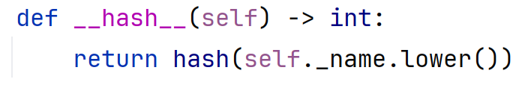
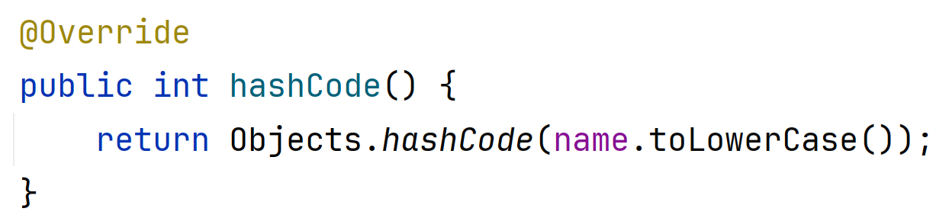
“Good Practice” Methods in Java:
Creating a Hash
  In python, we use __hash__()
    Takes one parameters (needs self)
    Returns an int representing the data
    Not always implemented – only used on data that won’t change!
  In Java, we use hashCode()
    No parameters
    Returns an int representing the data
    Should ALWAYS be consistent with equals()

Slide 11
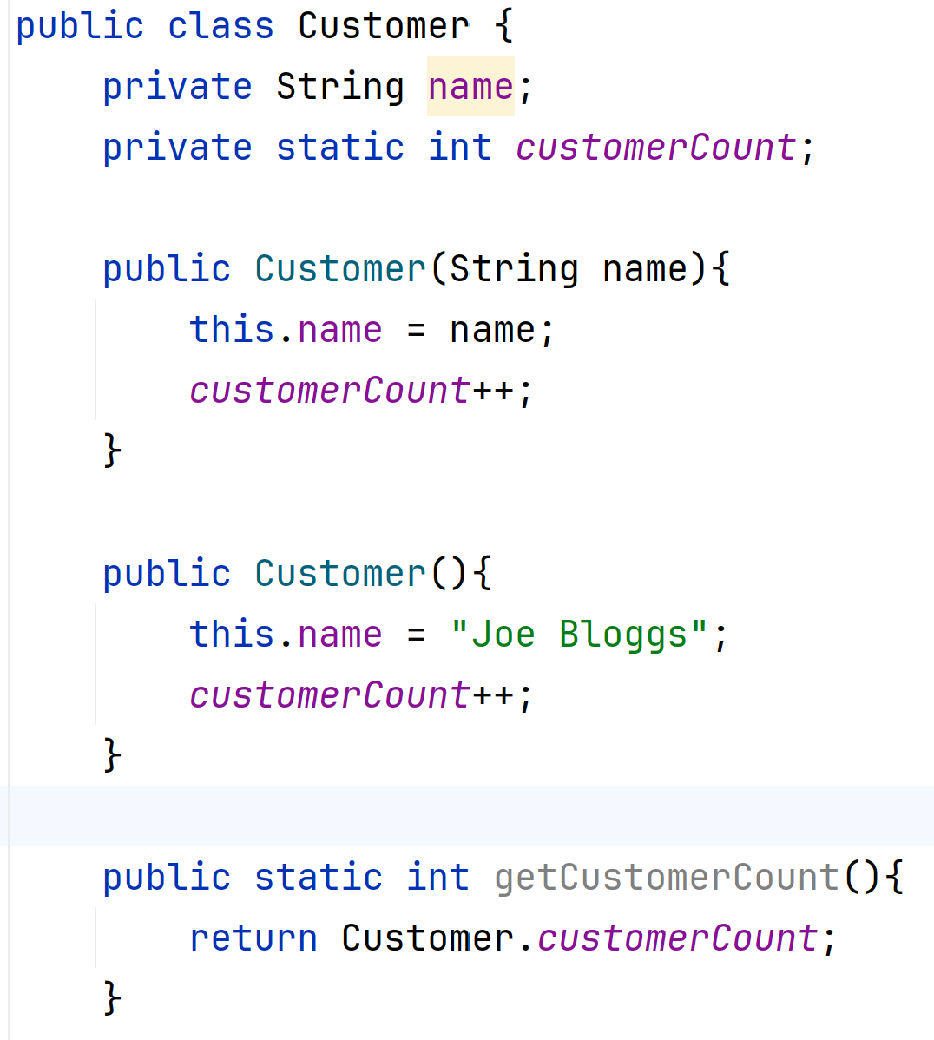
Class-Level Attributes and Operations:
Static Variables and Methods
  Python defines static variables implicitly
    Variable declared outside __init__ = static
    Variable declared using class name (ClassName.variableName) = static
  Python defines static methods explicitly using a decorator
  Java uses the static keyword for both
    Static variables are often in italics
  Both languages use the class name to refer to static components

